Slide 1
Winter Prep 2023-2024

Slide 2
Kansas Gas Service Winter Preparation
This updated presentation includes frequently asked questions about transportation services, account eligibility, rates, billing and situations that might occur during winter. The presentation also provides information about the Kansas Gas Service tariff revisions effective January 1, 2024, on electronic flow measurement (EFM) requirements, cash-out calculations, penalties and additional resourceful information.

Slide 3
Safety
Safety is our top priority

Slide 4
Natural Gas Pipeline Safety
Pipelines are one of the safest, most reliable methods of transporting natural gas. At times something may happen that allows gas to escape from your piping.
Here’s how you can use your senses to detect a natural gas leak
Smell A rotten egg or sulfur-like odor
Look Discolored or dead vegetation, persistent bubbling in puddles or standing water
Listen An unusual noise like a hissing or roaring sound can indicate a leak on a pipeline.

Slide 5
Natural Gas Pipeline Safety
Pipeline Safety – Recognition – Action
Action
Should you detect one or more of the warning signs, leave the area immediately, going upwind if possible
Do not operate any electrical equipment, including lights
Warn others to leave the area with you
When in a safe area, call 911 and Kansas Gas Service at 888-482-4950 to notify emergency personnel
Excavation
If you intend to excavate, you must request underground facilities be located
Call 811 or visit kansas811.com to have your underground natural gas facilities located. After requesting locates, you must wait two full working days for underground utilities to be located

Slide 6
Kansas Gas Service
About us

Slide 7
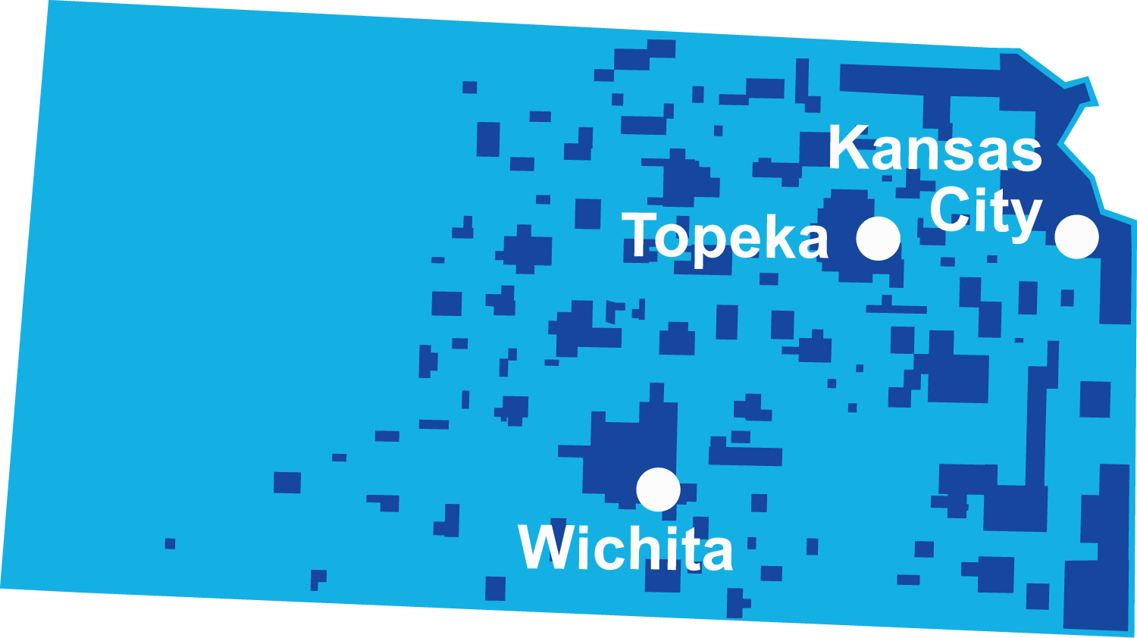
About Kansas Gas Service
Did you know?
Kansas Gas Service, a division of ONE Gas, Inc., delivers safe, reliable, environmentally friendly natural gas to more than 648,000 customers in 360 communities in Kansas
Largest natural gas distributor in Kansas
Total workforce of about 1,000 employees
7
Notes:
Stats as of Dec. 31, 2022; consistent with current Annual Report. Data be used until next Annual Report of March 2024.
Customers – 10-K section of Annual Report -- pg. 24
Employees – EOY 2022 # -- Provided by HR
Miles of Pipe – 10-K section of Annual Report -- pg. 16

Slide 8
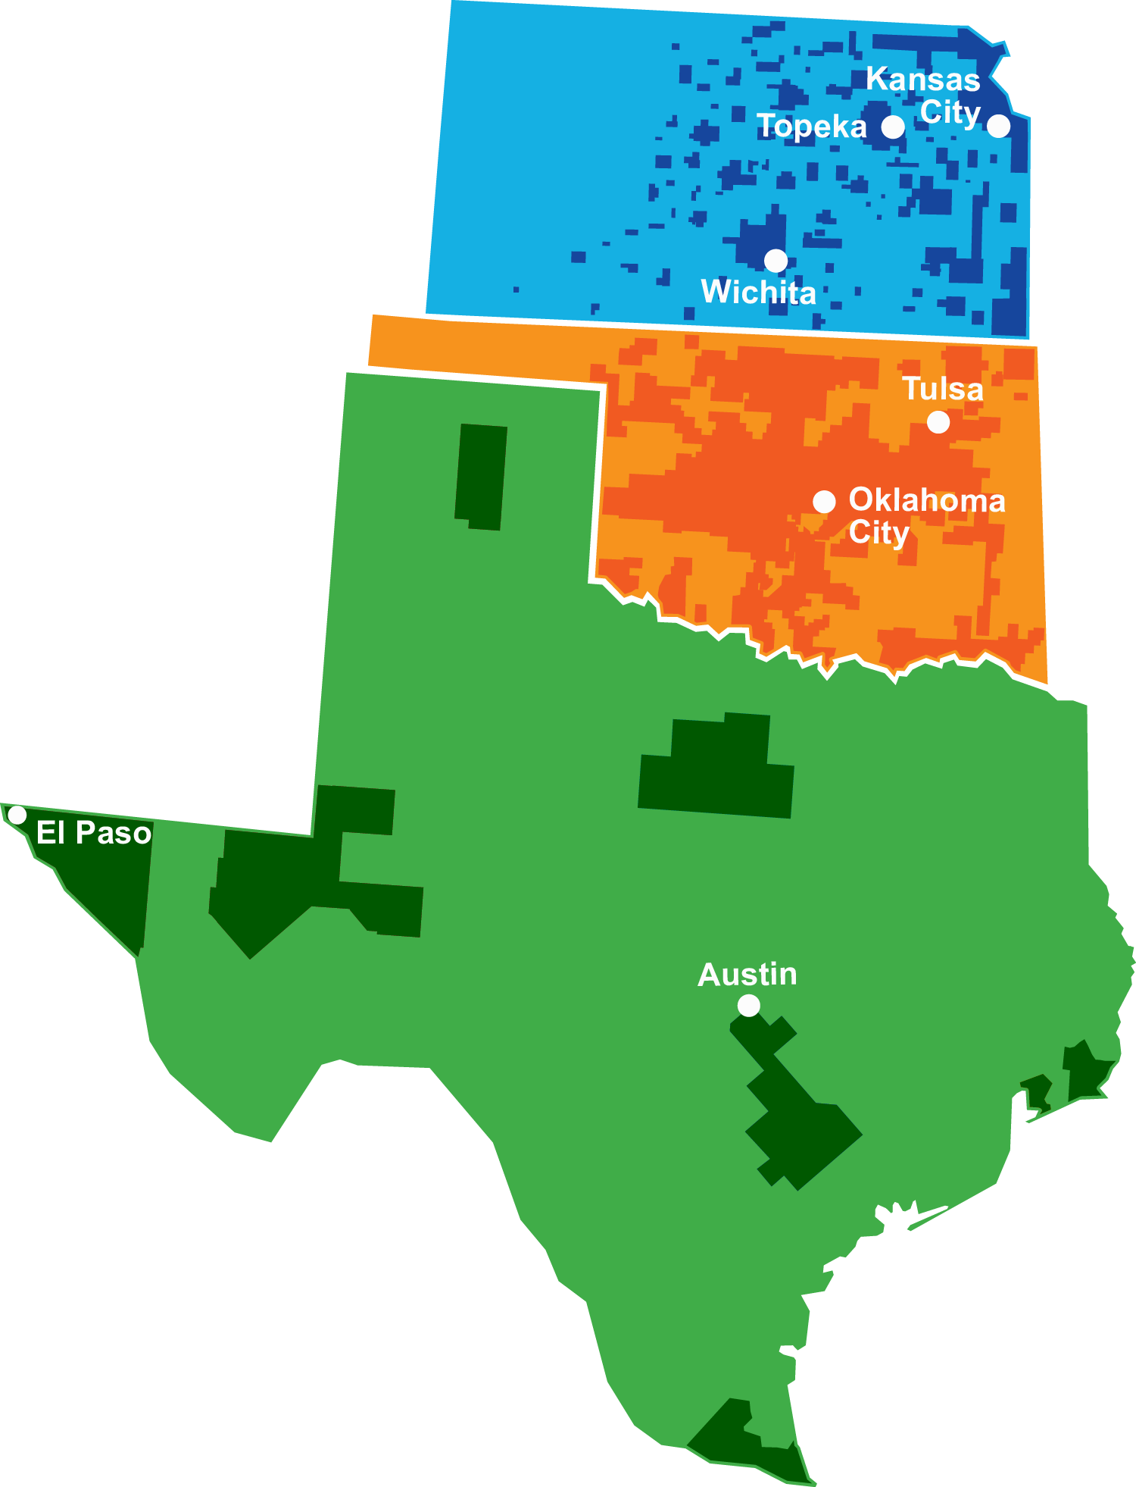
ONE Gas Overview
Our Divisions
100% regulated natural gas utility
2.3 million customers in Kansas,
Oklahoma and Texas
Kansas
71% market share, the largest in Kansas
Oklahoma
3,800 employees
44,500 miles of pipeline
Texas
88% market share, the largest in Oklahoma
One of the largest publicly traded natural gas distribution companies
13% market share, the third largest in Texas
More than 100 years of experience
in the natural gas industry
Notes:
Stats as of Dec. 31, 2022; consistent with current Annual Report. Data be used until next Annual Report of March 2024.
2.3 mil customers – 10-K section of Annual Report -- pg. 24
Employees – 10-K section of Annual Report -- pg. 10
Miles of Pipe – 10-K section of Annual Report -- pg. 16
Market Share – 10-K section of Annual Report -- pg. 6

Slide 9
Natural Gas: Where Does it Come From?

Slide 10
Wellhead to Burner Tip

Slide 11
How Does Natural Gas Get to My Business?
Process
Producers drill and operate gas wells
Gathering systems are used to bring raw natural gas to a processing plant
Processed natural gas is delivered to a transmission pipeline
Pipelines provide high pressure transmission – federal or state regulation
3rd party gas marketer (choice of many) buys and delivers natural gas to the appropriate town border station – unregulated
Local Distribution Company (Kansas Gas Service) moves the natural gas from the town border to your location – state regulation

Slide 12
Transportation Tariffs
About Transport Service, Statistics, Qualifications, Requirements

Slide 13
What is Transportation Service?
Provides the flexibility to make critical business decisions related to your natural gas supply requirements
More information on our Transportation tariffs may be found by visiting kansasgasservice.com and clicking on Choose Gas > Transportation Services

Slide 14
Kansas Gas Service Transportation
Statistics
Transportation service makes up more than half of the total natural gas that flows through the Kansas Gas Service distribution system
3,636 accounts
5,763 gas meters
20 active third-party natural gas suppliers
Contact information of the approved third-party suppliers is available on our website at this link: Kansas Gas Service – Natural Gas Transportation Services Third-Party Suppliers

Slide 15
Can Any Customer Qualify for Transportation Service?
Qualifications
Annual total usage of more than 800 Mcf (Mcf = 1,000 cubic ft)
Meters on contiguous property can be consolidated/aggregated for qualification
All K-12 schools and irrigators regardless of usage
Kansas Gas Service must receive all customer or customer’s Agent notices in writing, as well as a transportation affidavit, if applicable, for all account transitions by the 1st day of the month preceding the month in which the initiation to enter or leave transportation service is requested.

Slide 16
Do I Have to Stay on Transportation Service?
Tariff Requirements
Customer may, after giving 30 days advance notice, elect to transition from transportation service to a general sales service tariff. Upon making this transition, the account must remain on general sales service rate for a minimum of 12 months.
Do I have to qualify each year?
No, there is no annual re-qualification to remain on transportation

Slide 17
Third Party Natural Gas Suppliers

Slide 18
What is a Natural Gas Supplier
A third-party natural gas supplier purchases the natural gas commodity on your behalf from independent producers or major energy companies
Your contracted third-party natural gas supplier arranges delivery of your gas to your assigned town border station
Kansas Gas Service is not privy to the contracts between the customers and the third-party natural gas suppliers

Slide 19
How Does the Natural Gas Supplier Notify Kansas Gas Service?
Nominations on your behalf
Your natural gas supplier notifies Kansas Gas Service and the pipeline of the total amount of natural gas they will deliver for their total aggregated pool of customers. Individual nominations are not required when a customer is part of an aggregated pool.
Non-aggregated customers’ natural gas suppliers make the
notifications individually

Slide 20
Electronic Flow Measurement (EFM)
Requirements for transportation service

Slide 21
Do I Need a Special Meter to be on Transport?
Effective January 1, 2024, an EFM device is required on ALL Transport meters.
All K-12 public schools and irrigators on transport rates whose 3-year rolling average annual usage is less than 3,000 Mcf will be exempt from the EFM installation requirement.
For EFM meters, daily volume reports are available to customers and marketers via email
Kansas Gas Service has a 3-year roll-out period to install EFM on all transport meters. Kansas Gas Service will notify customers ahead of EFM installation when schedule is known.

Slide 22
EFM Installation Information
Kansas Gas Service will be installing cloud-based EFM devices.
In most instances, this will not require the customer to install A/C power.
The cost to the customer is $2,400 per EFM installation per meter.
Can be billed and paid in one installment
Or, the customer may elect the monthly equipment fee option ($23.77/month for 15 years)

Slide 23
Additional EFM Fees on Monthly Bill
After EFM installation is completed, customer will be assessed a monthly EFM fee of $32.40 per meter which consists of $17.40 EFM fee, plus $15.00 company-maintained cellular data service.

Slide 24
Transportation Rates

Slide 25
Transportation Tariff Rates
K- System & T- System
Small Transportation Service (ST) rates effective January 1, 2021
$55.66/mo./meter plus $1.4598/Mcf/delivery (k-system)
$55.16/mo./meter plus $1.9170/Mcf/delivery (t-system)
Large Volume Transportation (LV) rates effective January 1, 2021
$249.46/mo./meter plus $0.9023/Mcf/delivery (k-system) for Tier 1 volumes
$341.68/mo./meter plus $1.3521/Mcf/delivery (t-system) for Tier 1 volume
T-System rates are higher because they include Kansas Gas Service-owned transmission line costs

Slide 26
Additional Bill Charges & Riders
Monthly EFM fee
Franchise fees (if applicable)
Ad Valorem Tax Surcharge
Gas System Reliability Surcharge (GSRS)
Weather Normalization (Small Transport tariff only)
Gas commodity can be found on marketer billing and non-aggregated customer billing
Lost & Unaccounted (L&U) fuel – marketer billing
For complete listing of rates and riders, utilize the link on our website, kansasgasservice.com/rate-information/tariffs

Slide 27
What is a General Sales Service Account?
Kansas Gas Service provides the natural gas commodity, storage, pipeline transportation, local delivery, metering, and billing
Everything necessary to provide service is provided by one company with one monthly bill

Slide 28
Transportation Services Billing

Slide 29
What is Aggregation
Marketers and suppliers enter into agreements with Kansas Gas Service to establish aggregation groups
Third-party natural gas suppliers are allowed to aggregate customer imbalances during Operational Flow Orders (OFOs) or Periods of Curtailment (POCs) within aggregation areas established by Kansas Gas Service
Kansas Gas Service will notify the marketer of OFO or POC
Aggregation also applies to monthly cash-out

Slide 30
How is Cash-Out Price Determined?
Effective January 1, 2024, per general terms & conditions section 10, these prices will be applicable to the cash out of imbalances on any pipeline serving the Kansas Gas Service service territory.
Highest cash-out price shall be defined as the highest average daily midpoint price of the applicable month as published in Platts Gas Daily for the pipelines Southern Star, Panhandle, ANR and NGPL.
Lowest cash-out price shall be defined as the lowest average daily midpoint price of the applicable month as published in Platts Gas Daily for the pipelines referenced above.

Slide 31
Monthly Cash-Out (Usage Greater Than Nomination)
If Kansas Gas Service retainage adjusted receipts for the customer are less than deliveries to the customer, the customer or the customer’s agent shall pay:
No charge for each MMBtu of cumulative imbalance up to the greater of 5% of actual usage or 25 MMBtu per customer, to be carried over on account to the following month.
The highest cash-out price plus $0.15 for each MMBtu of imbalance which is greater than 5%, up to and including 10% of actual usage, and
The highest cash-out price plus $0.30 for each MMBtu of imbalance which is greater than 10% of actual usage.

Slide 32
Monthly Cash-Out (Usage Less Than Nomination)
If Kansas Gas Service retainage adjusted receipts for the customer exceed deliveries to the customer, the non-aggregated customer or the aggregated customer’s agent shall pay:
No payment for each MMBtu of cumulative imbalance up to the greater of 5% of actual usage or 25 MMBtu per customer, to be carried over on account to the following month.
The lowest cash-out price minus $0.15 for each MMBtu of imbalance which is greater than 5% of actual usage, up to and including 10%, and
The lowest cash-out price minus $0.30 for each MMBtu of imbalance which is greater than 10% of actual usage.

Slide 33
Operational Flow Orders (OFO)

Slide 34
What Operation Orders Can be Called?
Standard Operational Flow Order
Emergency Operational Flow Order
Period of Curtailment (POC)

Slide 35
Why are Operational Orders Necessary?
Conditions require transport receipts and deliveries to be in balance to protect the integrity of the company’s system or to ensure compliance with upstream pipeline requirements
Over-Delivery
Customer uses more than third-party natural gas supplier supplied
Under-Delivery
Third-party natural gas supplier provides more than customer uses

Slide 36
Notification of an OFO
Kansas Gas Service notifies all natural gas suppliers
Aggregated transport customers should be notified by their natural gas supplier
Non-aggregated customers will be notified by Kansas Gas Service
Kansas Gas Service annually conducts “mock” or practice notification drills in late summer or early fall

Slide 37
Required Daily Quantity (RDQ) & Electronic Flow Measurement (EFM)

Slide 38
What is an RDQ?
RDQ = Required Daily Quantity.
RDQ balancing is available to meters using less than 1,500 Mcf in the peak month for 12 months ending April 30
The predetermined RDQ amount is assigned by Kansas Gas Service and is to be delivered each day of an OFO or POC (Over-Delivery)
With the new tariff effective Jan. 1, 2024, and after Kansas Gas Service finishes installing EFM on all Transport meters except those exempt, an RDQ will not be necessary. However, meters exempt from the EFM requirement will need an RDQ.

Slide 39
When Do I Receive My Annual RDQ?
Notifications are mailed by August 1, effective November 1
RDQ balanced meters are not read during an OFO or POC
Zero tolerance for delivering less than the assigned RDQ
Nomination applied to RDQ first and balance to any applicable EFM meter
The customer or customer’s agent shall inform Company of any dispute over the RDQ within 30 days of their notification.
If you are unsure of your RDQ obligation, please contact your representative at Kansas Gas Service

Slide 40
What if I Can’t Possibly Use My RDQ?
You can receive a temporary RDQ assignment upon written request and approval by Kansas Gas Service
Must be a significant event
Request must be received by Kansas Gas Service prior to 72 hours of an occurrence of a significant event
Effective for period of event, must renew if more than 30 days

Slide 41
With EFM Meters, How Can I Be Compliant?
Over-Delivery Penalties:
May be assessed during an OFO (Operational Flow Order) or POC (Period of Curtailment)
May be assessed to any customer or aggregation group using natural gas in excess of authorized volumes
Apply to unauthorized Over-Deliveries to EFM meters which are not within 5% of authorized daily delivery levels or to RDQ balanced meters with nominations less than the assigned RDQ
Company may also distribute upstream penalties for unauthorized Over-Deliveries resulting from transport customer deliveries
See KGS tariff GTC11 for details: General Terms and Conditions 11

Slide 42
Penalties

Slide 43
Penalties Explained – Effective Jan. 1, 2024
Standard OFO Penalties
For each day of the Standard OFO, the lessor of 2 ½ times the daily midpoint stated on Platts Gas Daily’s Index for Southern Star times the MMBtu of Unauthorized Over-or-Under-Deliveries that exceed the tolerance level applicable under Section 11.06.01 or $15 plus the daily midpoint stated on Platts Gas Daily’s Index for Southern Star times the MMBtu of Unauthorized Over-or-Under-Deliveries.
Emergency OFO Penalties
For each day of the Emergency OFO, the lessor of 5 times the daily midpoint stated on Platts Gas Daily’s Index for Southern Star times the MMBtu of Unauthorized Over-or-Under-Deliveries that exceed the tolerance level applicable under Section 11.06.01 or $50 plus the daily midpoint stated on Platts Gas Daily’s Index for Southern Star times the MMBtu of Unauthorized Over-or-Under-Deliveries.
Period of Curtailment Penalties
For each day of the POC, the lessor of 10 times the daily midpoint stated on Platts Gas Daily’s Index for Southern Star times the MMBtu of Unauthorized Over-or-Under-Deliveries that exceed the tolerance level applicable under Section 11.06.01 or $100 plus the daily midpoint stated on Platts Gas Daily’s Index for Southern Star times the MMBtu of Unauthorized Over-or-Under-Deliveries.

Slide 44
Price Spike Event-Effective Jan 1, 2024
An OFO or POC of over-deliveries with price spike event is defined as each day during an OFO or POC of Over-Deliveries where the daily midpoint stated on Platts Gas Daily’s Index for Southern Star equals or exceeds 5 times the first of the month Platts Gas Daily’s Index for Southern Star for the same month.
Please access this link to see details of event credit levels and calculations: KGS General Terms and Conditions Section 11 (kansasgasservice.com)

Slide 45
Avoiding a Cold Weather Penalty
Make sure your third-party natural gas supplier delivers your RDQ amount
Limit your usage for your EFM meter to stay within tolerance of your nomination (plus or minus 5%)
Have your third-party natural gas supplier adjust/increase your delivery so that you remain in compliance

Slide 46
Penalties Collected
Penalty money is used to pay pipeline penalties and/or lower the cost of gas (COGR) for Kansas Gas Service’s sales customers
Kansas Gas Service has no financial incentive to issue an operational flow order or period of curtailment

Slide 47
Curtailment

Slide 48
Possible Conditions
A supply curtailment could be issued after an OFO has been implemented and in situations where supplies may not be sufficient to maintain service to priority customers (e.g., loss of service would endanger human life)
Under a system emergency, natural gas diverted from transport customers to higher priority customers would be reimbursed at verifiable replacement cost

Slide 49
Types of Curtailment
Local system curtailment - Issued on short notice when demand on a portion of the Kansas Gas Service system exceeds the delivery capability of the system
System-wide curtailment - Issued on short notice when demand on all of the Kansas Gas Service system exceeds the delivery capability of the system
Customer notified by third-party natural gas supplier that transportation and sales service is curtailed based on end-use categories stated in the Company’s Priority of Service tariff provisions
Any natural gas used above that authorized in the categories curtailed is unauthorized Over-Delivery and subject to penalty

Slide 50
Curtailment Sequence
Large Volume Transport
Small Transport, General Sales and customers with endangered property
Residential and customers with endangered human life

Slide 51
Market Outlook

Slide 52
Index Pricing, Kansas Gas Service COGR
Historical index pricing, Kansas Gas Service cost of natural gas

Slide 53
Forecasting: 2023-2024
Market Volatility
Neither ONE Gas nor Kansas Gas Service can predict future natural gas commodity prices due to domestic and geopolitical factors.
War in Ukraine
The prediction of an El Nino winter with a stronger, southern storm track may lead to Kansas having normal ranges of snowfall, with the southwest portion of the state slightly higher than normal.
Liquified Natural Gas (LNG) plants
Natural gas-fueled power plants experienced increased demand from record-high summer temperatures
Production lags demand
Other helpful links:
EIA Outlook EIA U.S. Energy Information Administration

Slide 54
Securitization

Slide 55
Securitization
Kansas Gas Service was allowed to issue securitized utility tariff bonds to recover qualified extraordinary costs from Winter Storm Uri.
10 years for recovery of costs using a fixed monthly charge and is a separate line item on General Sales customers’ bills. (began Dec. 1, 2022)
Transportation customers will not be assessed this fee.
Sales customers who become Transportation customers while securitization charges are being recovered must pay a Settlement Fee.
If you have a new meter that you intend to add to the Transportation tariff, please notify your account rep and inform the Customer Service Representative when you call in to activate the meter.

Slide 56
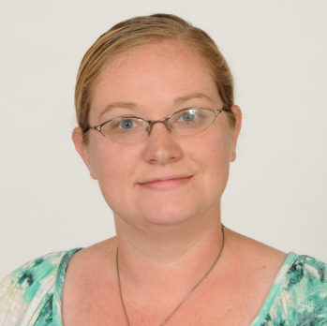
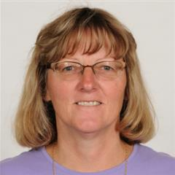
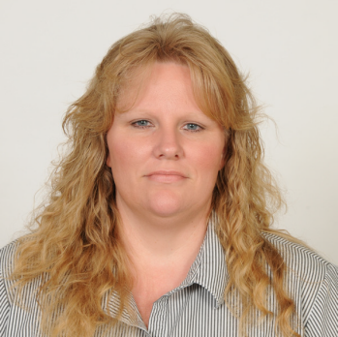
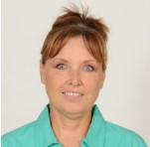
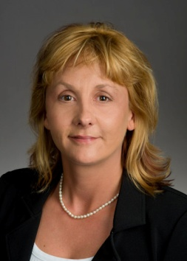
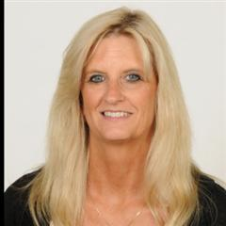
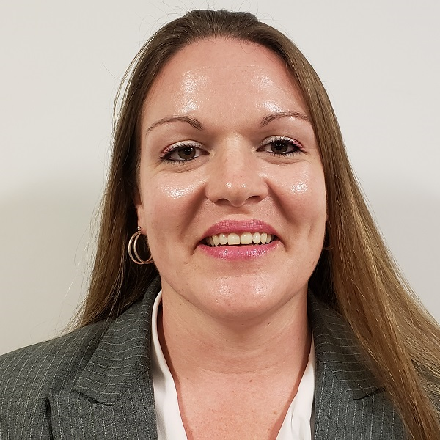
Transportation Services Staff
Nicole Williams
Ronda Geisen
Patty Cleaver
Carolyn Punches
Marion Miller
Lindi Workman
Melissa Warrender
Karren Chambers

Slide 57
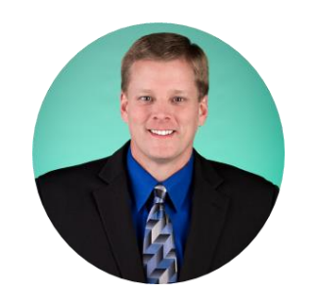
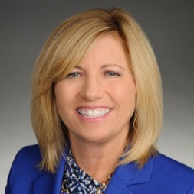
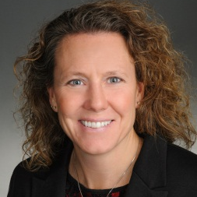
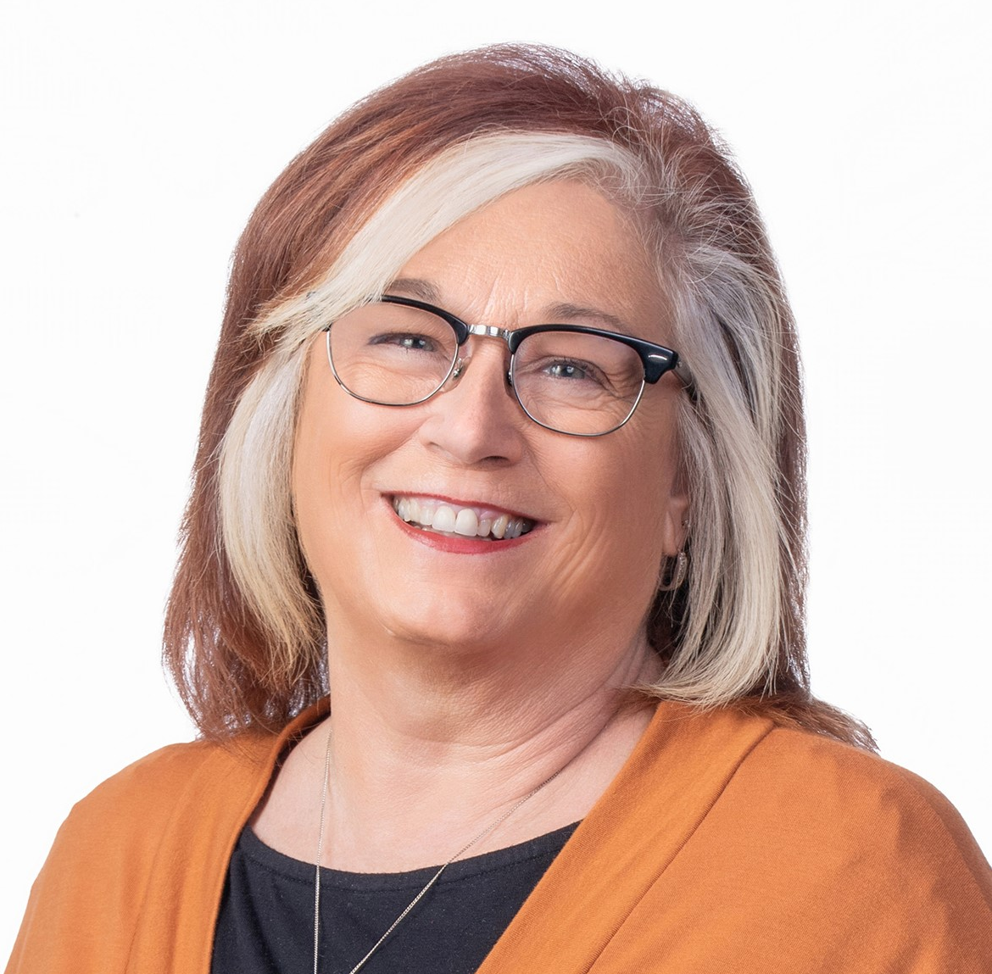
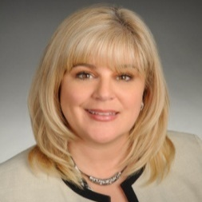
Key Accounts Staff
Susan Marx
Manager, Key Accounts
913-319-8709
susan.marx@onegas.com
Ron Ediger
Sr. Key Account Rep
785-271-3943
ron.ediger@onegas.com
Tonya Kohr
Sr. Key Account Rep
620-728-4313
tonya.kohr@onegas.com
Carrie Shankar
Key Account Rep
316-832-3162
carrie.shankar@onegas.com
Ryan Browning
Sr. Key Account Rep
913-344-8848
ryan.browning@onegas.com
Debbie Ferguson
Sr. Key Account Rep
913-344-8810
debbie.ferguson@onegas.com
57

Slide 58
Area Key Account Representatives
Primary Contact For Transport Accounts Within Their Areas
Debbie Ferguson – North Kansas City Metro & Northeast Kansas
Ryan Browning – South Kansas City Metro, Southeast Kansas and Northwest Central Kansas (Salina)
Ron Ediger – Northeast Central Kansas (Topeka)
Tonya Kohr – Western Kansas (Hutchinson)
Carrie Shankar – South Central Kansas (Wichita)

Slide 59
Thank you!
For additional questions, please contact your local Key Account Representative.

